Slide 1

Watchdog Timer (WDT)
The Sentinel of Reliability in Embedded Systems
Author: BinhLV13

Slide 2

Introduction to Watchdog Timers
Acts as an independent sentinel.
Covers STM32 and TRAVEO T2G microcontrollers.
Constantly monitors MCU health and execution.
Promotes highly available embedded systems.
Crucial for fault-tolerant applications.
Ensures robustness in critical environments.

Slide 3
Abbreviations & Acronyms
Term | Description
MCU | Microcontroller Unit.
WDT / WDG | Watchdog timer / Watchdog.
IWDG | Independent watchdog.
WWDG | Window watchdog.
EWI | Early Wakeup Interrupt.
LSI | Low-Speed Internal oscillator (typically ~32 kHz).

Slide 4

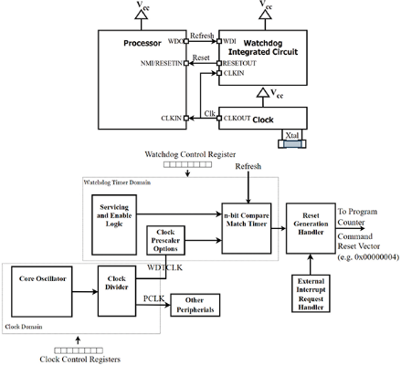
WDT Overview & Mechanism
Acts as a hardware fail-safe mechanism.
Main software sends periodic pings.
Detects system freezes or infinite loops.
Triggers automatic system reset on timeout.
Ensures autonomous recovery without human intervention.

Slide 5


Applications & Solutions
Safety Critical Applications
WDT Implementations
Required for functional safety.
Internal hardware: Minimizes size and cost.
Vital in automotive systems (ISO 26262).
External hardware: Highest reliability, independent IC.
Prevents fires in home appliances.
Lowers operational risk to an acceptable level.
Software timers: Based on system clock interrupts.
Internal WDTs provide adequate reliability generally.

Slide 6

WDT Operation: Standard Mode
Features a single pulse operation.
Counts to a pre-defined limit.
Resets MCU automatically on a missing pulse.
Drawback: May miss early faults.
Accepts rapid inputs without triggering errors.

Slide 7
WDT Operation: Window Mode
Monitors a min and max pulse window.
Detects both missed and double pulses.
Prevents too-early or too-late servicing.
Increases accuracy in complex embedded systems.
Ensures precise execution timing.

Slide 8
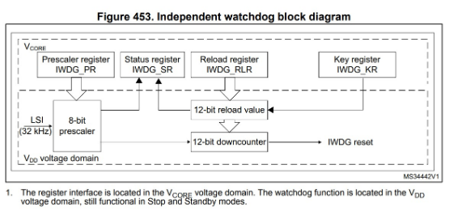
STM32: Independent Watchdog (IWDG)
Based on a 12-bit downcounter.
Clocked by an independent 32 kHz LSI.
Operates reliably in Stop and Standby modes.
Ideal for standalone fault recovery.
Hardware or software configurable startup.

Slide 9
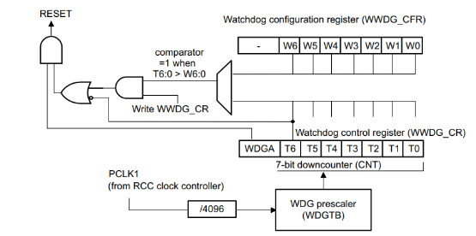
STM32: Window Watchdog (WWDG)
Based on a 7-bit downcounter.
Clocked directly from the main clock (APB1).
Enforces refreshes within an accurate time window.
Features an Early Wakeup Interrupt (EWI).
Best for applications needing precise timing.

Slide 10
Key Differences: IWDG vs WWDG
Feature | IWDG | WWDG
Clock Source | LSI (Independent, 32kHz) | APB1 (Derived from system)
Timing Precision | Less precise | Highly precise
Refresh Logic | Anytime before timeout | Must be within a valid window
Interrupts | None before reset | Supports Early Wakeup (EWI)
Best Use Case | Safety-critical fault recovery | Precise timing error detection

Slide 11
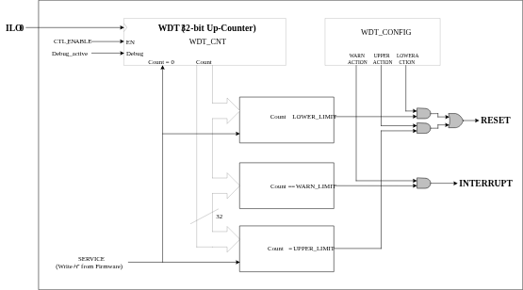
TRAVEO T2G: Basic WDT
Features a 32-bit up-counter (32.768 kHz).
Utilizes LOWER, WARN, and UPPER limits.
Generates pre-warning interrupts or resets.
Protected by strict hardware unlock sequences.
Can act as a wakeup capability source.

Slide 12
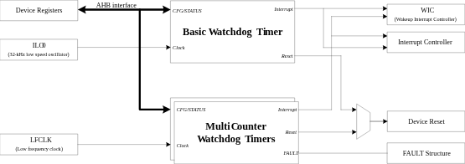
TRAVEO T2G: Multi-Counter WDT
Integrates two 16-bit and one 32-bit counters.
Provides granular monitoring across multiple tasks.
Enables functional safety (ASIL-B) containment.
Highly configurable warning and fault actions.
Functions as a low-power wake-up source.

Slide 13
Summary & Closing
WDTs are the core of fault-tolerant MCU design.
Choose between standard, windowed, IWDG, WWDG, or MCWDT based on precise application safety needs.
Questions?

Slide 14






Image Sources
https://assets.incompliancemag.com/2025/04/2505-F1-fig1.png
Source: incompliancemag.com
https://cf-images.us-east-1.prod.boltdns.net/v1/static/3816841626001/ddf6cf73-7adc-4151-bd8f-0277b40c243a/cc19e9ac-6341-4a02-ac77-77d9b1407f22/1280x720/match/image.jpg
Source: www.ti.com
https://kajabi-storefronts-production.kajabi-cdn.com/kajabi-storefronts-production/file-uploads/blogs/2148030645/images/7cc3e8-6ab6-de7c-4c02-4f46022d436_stm32_independent_watchdog_block_diagram.jpg
Source: www.steppeschool.com
https://miro.medium.com/1*G2_jSedlsiFvikMIxWbWxA.png
Source: kunalsalvi63.medium.com
https://documentation.infineon.com/traveo/assets/images/iee1681542259905-c341733b3415ffcb217bfa0208680f73.svg
Source: documentation.infineon.com
https://documentation.infineon.com/traveo/assets/images/nwx1681542000581-18cabc69f28d4a2b37ba1a4f08fa409c.svg
Source: documentation.infineon.com

